Slide 1
Capstone Project 2 Money Manager
Group F3
Roll numbers: 11-16

Slide 2
What is Money Manager ?
Money Manager is a web based application dedicated to help people manage their money
We help people to manage their expenses and invest for a better future
The main focus of this project is to eradicate the illiteracy and thus the enforced fear about financial planning in today’s youth

Slide 3
Objectives
This money management system helps optimize money, which allows you to plan more effectively.
Perhaps the most vital objective of any money management system is limiting your money outflow and accelerating money inflow.
To ensure safety on investment, i.e. funds should be invested in safe ventures so that adequate rate of return can be achieved.
To make it easier to use the website and introduce the user to the UI
To help users in greater extent in investing by price prediction

Slide 4
Objectives
The main aim of our project is to improve the financial intelligence in today’s youth.
The project has a expense management utility to help the youth manage the expenses.
Another survey on the internet displayed that even though there are other applications like these a collective platform lacked to exist, till now.

Slide 5
Features
Chat bot
A chat bot is a software application used to conduct an on-line chat conversation via text or text-to-text speech.
Chat bots are used in dialog system for various purposes including customer service or information gathering.
The current scenario of financial uncertainty brought on by the pandemic has underlined the need for 24/7 personal finance chat bots.
Chat bots also help users in completing financial transactions.

Slide 6
Features
Stock Prediction
Stock market prediction is the act of trying to determine the future value of a company stock or other financial instrument traded on an exchange. The successful prediction of a stock's future price could yield significant profit.
This website helps you to predict the stock using machine learning and deep learning.

Slide 7











Tools Used
For Frontend Development
HTML CSS Javascript Bootstrap jQuery
For Backend Development and Database Management
Django PostgreSQL Python Numpy Tensorflow
Hosting Service

Slide 8
Technologies Used
Artificial Intelligence
Artificial intelligence (AI) is the simulation of human intelligence processes by machines, especially computer systems. Specific applications of AI include expert systems, natural language processing (NLP), speech recognition and machine vision.
AI processes large amounts of data much faster and makes predictions more accurately than humanly possible.

Slide 9
Technologies Used
Machine learning
Machine learning is a method of data analysis that automates analytical model building. It is a branch of artificial intelligence based on the idea that systems can learn from data, identify patterns and make decisions with minimal human intervention.
Machine learning is a specific subset of AI that trains a machine how to learn.

Slide 10
Technologies Used
Deep learning
Deep learning is a subset of machine learning in artificial intelligence that has networks capable of learning unsupervised from data that is unstructured or unlabeled.
Deep learning is an AI function that mimics the workings of the human brain in processing data for use in detecting objects, recognizing speech, translating languages, and making decisions.
Deep learning AI is able to learn without human supervision, drawing from data that is both unstructured and unlabeled.

Slide 11
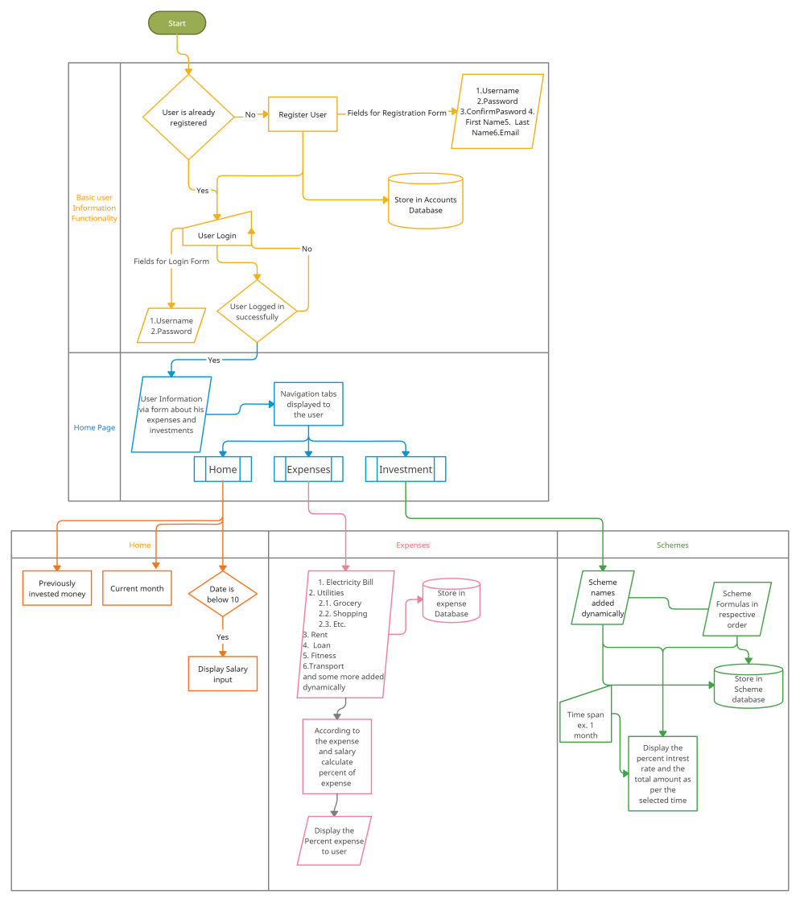
Methodology
Survey and Literature Review
Planning the workflow
Delegating the tasks
Completing the Frontend and backend simultaneously
Database management and data dynamics
Testing and debugging the final code
Security and user functionality testing
Hosting the code on the world wide web or internet

Slide 12
THANK YOU !

